Slide 1

Overview
Xamarin for Visual Studio Enterprise

Slide 2
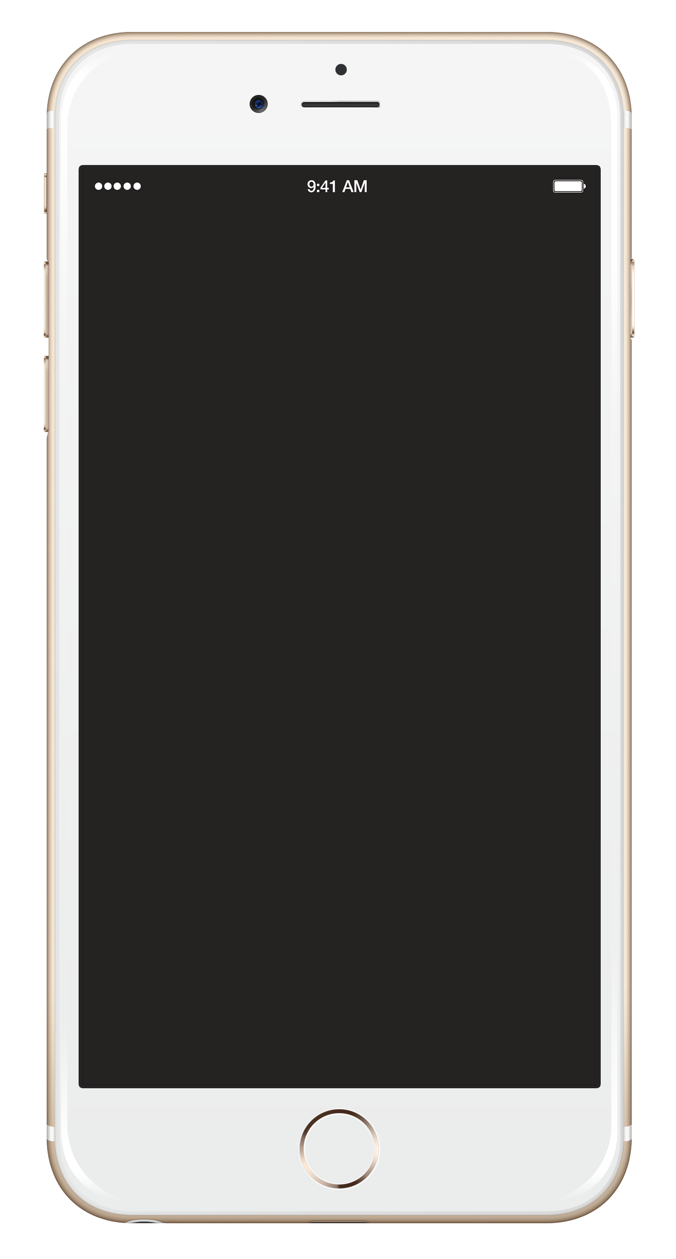
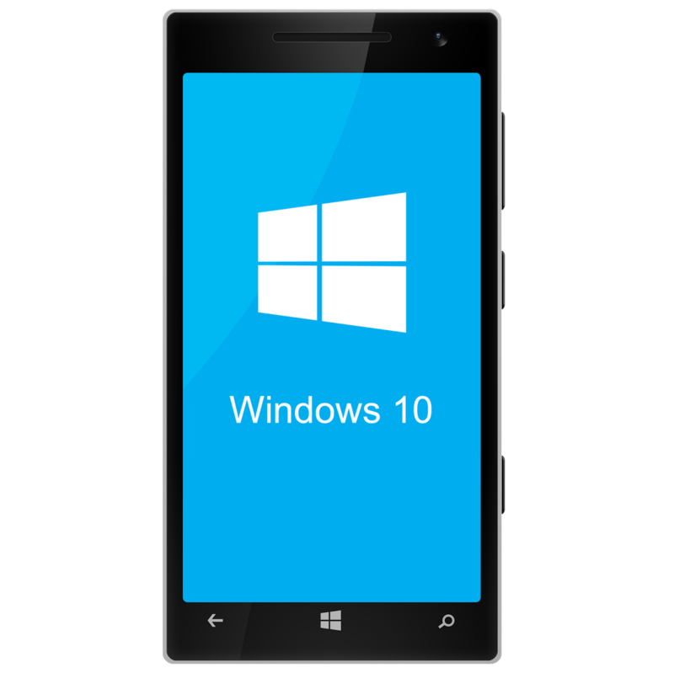
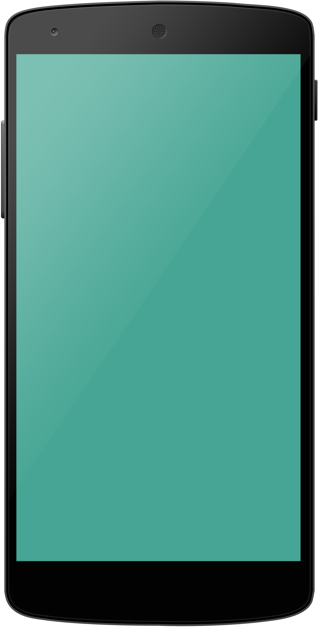



Xamarin’s unique approach Efficiency through shared code
More apps faster: Accelerated time-to-market with up to 100% shared code.
Truly native cross-platform solution: Native UI and performance, high-fidelity API access.
Easy scalability: Go from 1–100 apps with reduced time and effort.
Fully integrated solution: Easily connect with high value cloud services: MBaaS, data, MDM.
Native UI
Native UI
Native UI
Xamarin and C#
Shared Code
Notes:
SCRIPT
When mobile devices first came out, companies had to jump in with gusto. And they did so with what we call the siloed , platform-specific approach. They hired specific teams to build apps for one platform. Objective C for iPHone. Java developers for Android. Etc.
The benefit is that your app is very tailored to the platform that your users are engaging with it. And that’s what users want.
The downside is there is a lot of redundant work that occurs. You have three teams effectively building the same product for a different audience. It’s a very slow way to innovate and update. For every bug you find, you have to fix it three times.
What came from this was another approach to development: the hybrid or web approach. This is where you’re using Web technologies and putting a mobile wrapper around it. The benefit is that you save money. You can use your current Web teams. However, the performance of these applications is sub par at best. Mark Zuckerburg is famous for saying that betting too heavily on HTML 5 was one of the worst business decisions Facebook made. It’s unfortunate that a lot of organizations went this direction and this resulted in poor adoption rates and wasted investments.

Slide 3
More apps faster
5% Platform specific code
Xamarin’s unique technology empowers you to share up to 95% of your code across iOS, Android, and Windows phone.
95% Shared code
Customer references
McKesson reference - 90-95% shared code
Mars Petcare reference – 100% shared code
LA Department of Building and Safety reference – 90% shared code
Sample demo app (90 - 95% reuse) App-acquaint
Notes:
Up to 70% shared code with Xamarin.Platform and up to 100% shared code with Xamarin.Forms

Slide 4
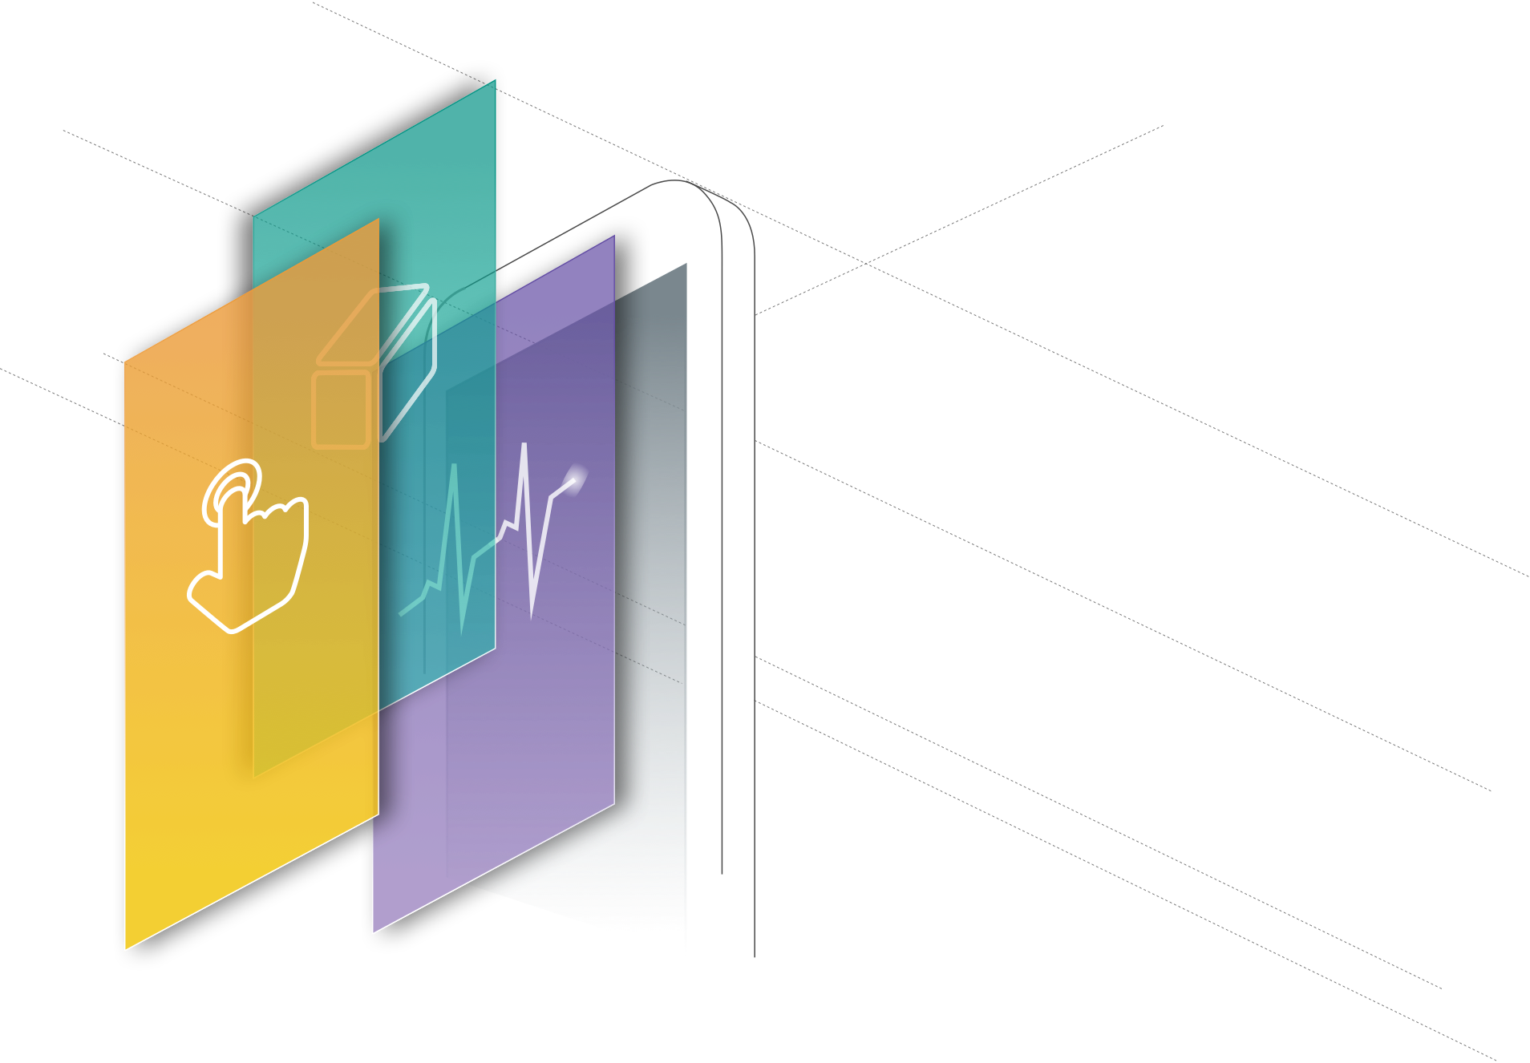
Truly native cross-platform solution
Anything you can do in Objective-C, Swift, or Java, you can do with Xamarin.
Native User Interface
Native Performance
High-fidelity API access
Notes:
Apps are built with standard, native user interface controls for easy and familiar interactions
Apps have access to the full spectrum of functionality exposed by the underlying platform and device.
Apps leverage platform-specific hardware acceleration, and are compiled as native binaries, not interpreted at runtime

Slide 5

Differentiated Xamarin value proposition
‘It’s the best of both worlds!’
C#
... for end users
Native user experience
Native performance
Native platform services
End user experience
Better TCO, productivity and development experience
... for developers
100% C# with 100% of platform APIs exposed
More productivity and faster development
Up to 70% code reuse with Xamarin
Up to 100% shared UI with Xamarin.Forms
One code base and IDE for client and backend
Notes:
Mobile is transformative because mobile apps are context-aware – and context-aware apps require full access to native device capabilities
Mobile users - consumers and employees alike - are more likely to abandon apps that show poor performance or non-standard UI, navigation and controls because it slows them down and forces them to re-learn things they already know
Xamarin takes .NET to the next level and extends it to iOS and Android
Xamarin apps are 100% C# and 100% of Android + iOS platform APIs are exposed
With Xamarin, everything you can do with Objective-C or Java, you can do with .NET
Xamarin apps are 100% native apps, indistinguishable from platform-native apps created with Android Studio, Eclipse or Xcode
Xamarin also includes powerful iOS and Android UI designers that enable you to create beautiful user experiences for Windows, iOS and Android in a visual designer with drag-and-drop simplicity
Xamarin enables developers to use the same languages, libraries, and tools for all major mobile platforms, unlocking the extraordinary productivity of .NET for any iOS and Android while using existing skills and enabling effortless sharing of code among platforms
With Xamarin, you can build native apps once and run them everywhere – giving developers the most productive and powerful platform for creating native cross-platform applications
The cross-platform native approach combines the benefits of both worlds - you get the native user experience for each individual platform, and you also eliminate rework and increase organizational innovation and responsiveness by delivering more apps faster

Slide 6







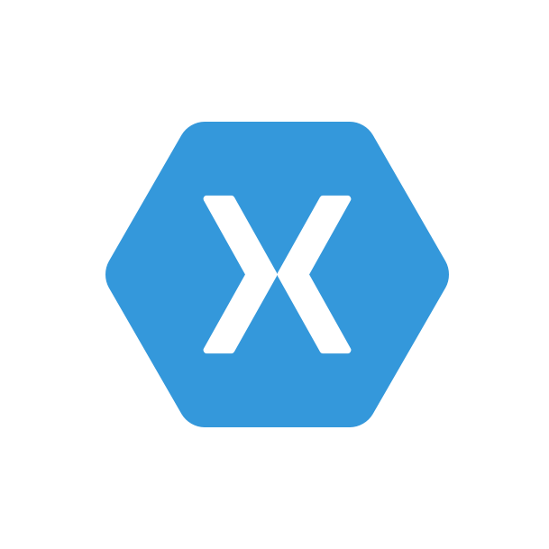
Microsoft’s end-to-end Mobile DevOps solution
Code Repository | Build + Deploy
App Testing
Beta Testing
Visual Studio Team Services
Backlog
Telemetry Collection
Users and customers install and use app
Application Insights
Monitor and improve
Notes:
Every project starts with an idea - and a plan how to turn this idea into reality – a new product or app feature.
Developers track and manage work in a dynamic backlog that is constantly updated.
Once an iteration starts, developers turn great ideas into features.
For this, they need shared services – for example source control - that enable them to collaborate as a team, write and test code and build functionality.
Whenever a developer checks in new code to the source control repository, a build is automatically triggered and after each successful build, automated integration and build verification tests run.
After the build has been successfully verified, it is automatically deployed to Xamarin Test Cloud and app testing commences – manual or automated UI testing on different devices, form factors and platforms.
The next step involves user beta testing – selected users and groups get access to the app, install and use it on their devices and provide valuable feedback that the development team actions.
Once a predefined quality bar has been reached, the app is deployed to the respective app stores and users and customer can install and use this app or update to the newest version.
Once installed, app telemetry data and performance and usage merics are monitored so that the development team can learn from real user interactions and evolve and improve the app in the next iteration – bugs and issues flow directly into the project backlog where they can be triaged and actioned appropriately.
Crash analytics helps developers identify app issues or bugs and enable fast root cause analysis and push out a fix or app update quickly.

Slide 7


Mobile DevOps benefits
Shrink release cycles significantly and push new apps out faster.
Ensure the highest quality user experience that keeps users continuously engaged.
Test on a broad range of devices to make sure apps work on your users’ devices
Focus on innovation, spend less time fixing bugs, and more time creating value.
Build apps faster
Keep users engaged
Reach more users
Build new features
Notes:
By using Microsoft’s mobile DevOps solution, customers will have the CONFIDENCE that they’re shipping apps that function how they INTENDED, and that users will LOVE.
They can ship faster, and continuously update their apps to ensure that the best version of there is always out there
They can be sure that each feature will work because they are continuously testing and monitoring.
They can be sure that their app will work for all devices in their user base with cross-platform support, and they can be sure that developers are comfortable with what they’re shipping.
With mobile DevOps, teams get more time to focus on what’s most important to keeping users engaged – more innovation, more new features.

Slide 8


